Slide 1
Prediction and Analysis of Stellar classification
dataset
Team Members:
Vedang Sawarkar (19BCE1303)
Divyanshi Thapa (19BCE1367)

Slide 2
Content
Abstract
Introduction
Scope
Expected Outcome
Dataset
Algorithm
Model
Flow Diagram

Slide 3
Abstract
Stellar classification is the classification of stars based on their spectral characteristics.
The classification scheme of galaxies, quasars, and stars is one of the most fundamental in astronomy.
The early cataloguing of stars and their distribution in the sky has led to the understanding that they make up our own galaxy and, following the distinction that Andromeda was a separate galaxy to our own, numerous galaxies began to be surveyed as more powerful telescopes were built.

Slide 4
Introduction
Due to evolution of powerful telescopes, extensive research began in astronomy. Data was collected using various methods containing extensive parameters. The fundamental thing in astronomy research is classifying the celestial body detected by telescopes as galaxies, stars and quasars. A quasar is a very bright, distant and active supermassive balckhole that is millions to billions times the mass of sun. Information collected by SDSS(Sloan Digital Sky Survey) will be used for training the models. Information like Ascension Angle’, ‘Declination Action’, Ultraviolet Filter, green, red and infrared filter, red-shift, etc. will be used to take decisions regarding classification. The dataset contains 1,00,000 records and 18 features.

Slide 5
Scope
The scope of this project aims at real time classification into stars, galaxy or quasars. The data can be collected easily from space telescopes and it can be immediately provided as input to the trained model and thus the model can predict what kind of celestial body it is.

Slide 6
Expected Outcome
The outcome of this project is to predict whether the detected celestial body is Star, Galaxy or Quasar. State-of-the-art classification models will be trained. Out of the given 17 input features, we will choose only those features which have maximum impact on the output variable.

Slide 7
Dataset
The data consists of 100,000 observations of space taken by the SDSS (Sloan Digital Sky Survey). Every observation is described by 17 feature columns and 1 class column which identifies it to be either a star, galaxy or quasar.
obj_ID = Object Identifier, the unique value that identifies the object in the image catalog used by the CAS
alpha = Right Ascension angle (at J2000 epoch)
delta = Declination angle (at J2000 epoch)
u = Ultraviolet filter in the photometric system
g = Green filter in the photometric system
r = Red filter in the photometric system
i = Near Infrared filter in the photometric system
z = Infrared filter in the photometric system

Slide 8
Dataset
run_ID = Run Number used to identify the specific scan
rereun_ID = Rerun Number to specify how the image was processed
cam_col = Camera column to identify the scanline within the run
field_ID = Field number to identify each field
spec_obj_ID = Unique ID used for optical spectroscopic objects (this means that 2 different observations with the same spec_obj_ID must share the output class)
class = object class (galaxy, star or quasar object)
redshift = redshift value based on the increase in wavelength
plate = plate ID, identifies each plate in SDSS
MJD = Modified Julian Date, used to indicate when a given piece of SDSS data was taken
fiber_ID = fiber ID that identifies the fiber that pointed the light at the focal plane in each observation

Slide 9
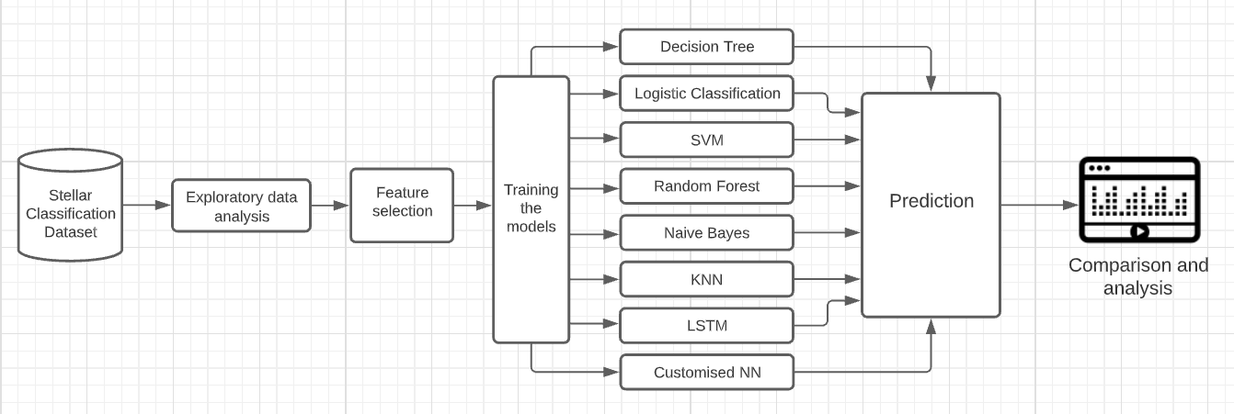
Flow Diagram

Slide 10
Algorithm
Exploratory data analysis of the stellar dataset.
Feature selection.
Training the models:
1. SVM
2. Decision tree
3. Random forest
4. Logistic classification
5. KNN
6. ANN
7. Naive Bayes
8. Custom Neural Networks
9. LSTM
Prediction and Comparison of the algorithm

Slide 11
Thank You

